Slide 1
INDIA’S TOP SOCIAL MEDIA INFLUENCERS
Report Compiled by
Thinking Hats Consumer Insights
Photo by freepik

Slide 2
With massive reach among the desired target cohorts, influencer marketing on social media works great for brands.
However, a brand needs to carefully select both – the social media platform and the influencer to invest in.
Thinking Hats has identified and put together the ‘INFLUENCER GUIDE’ for different product categories.

Slide 3
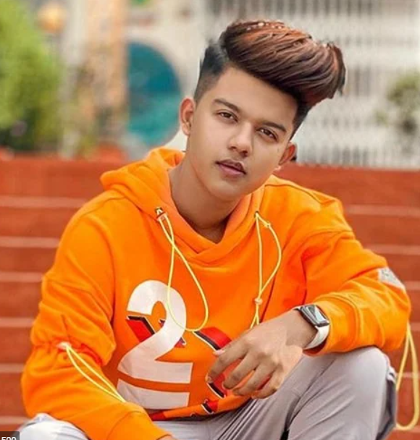
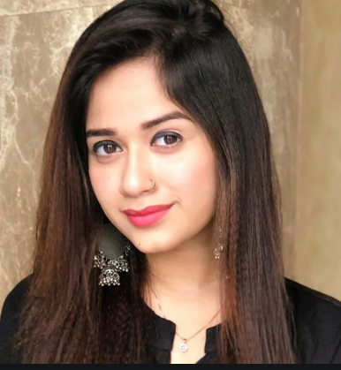
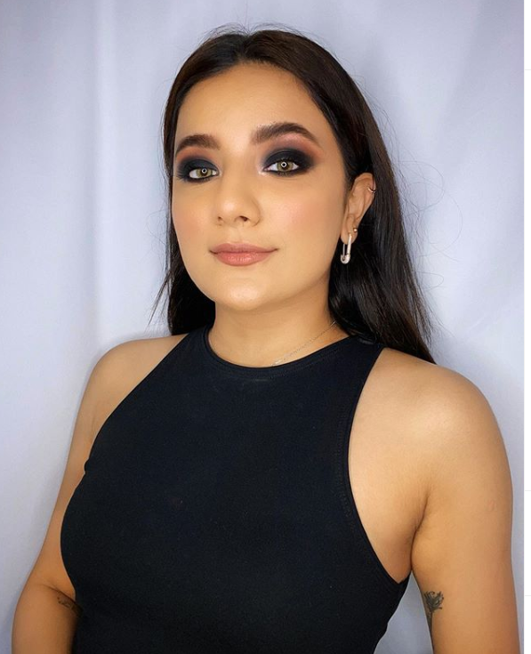
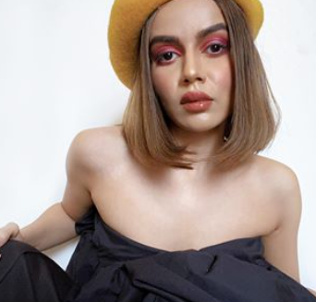
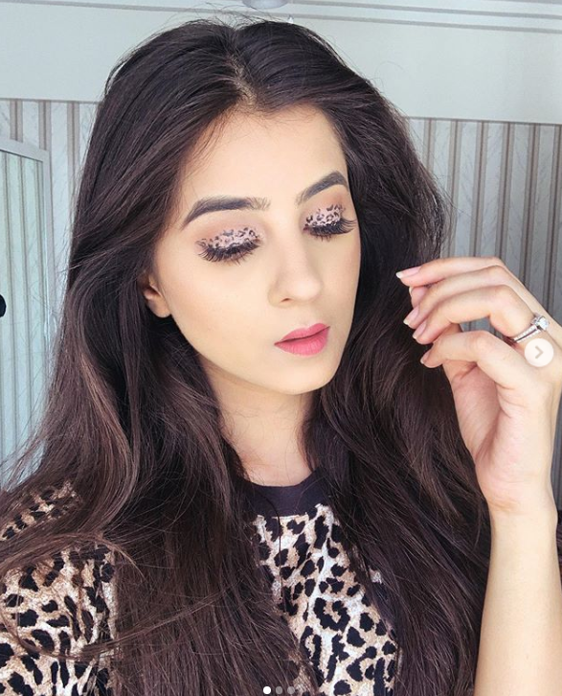
TOP FASHION INFLUENCERS
Riyaz Ali
41.2 M Followers
Jannat Zubair
27.2 M Followers
Mrunal Panchal
2 M
Followers
Komal Pandey
914 K Followers
Shaurya Tulshyan
404 K Followers

Slide 4
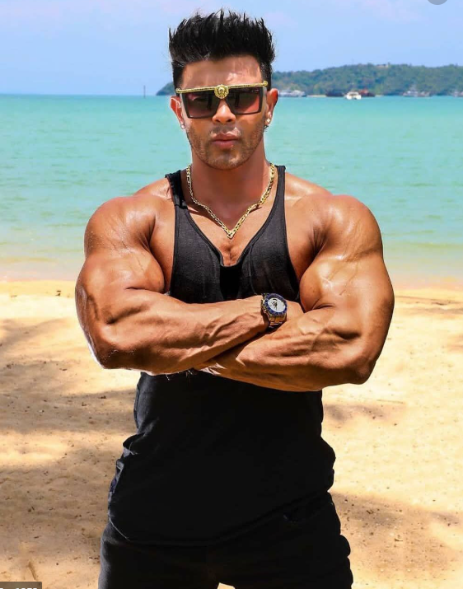
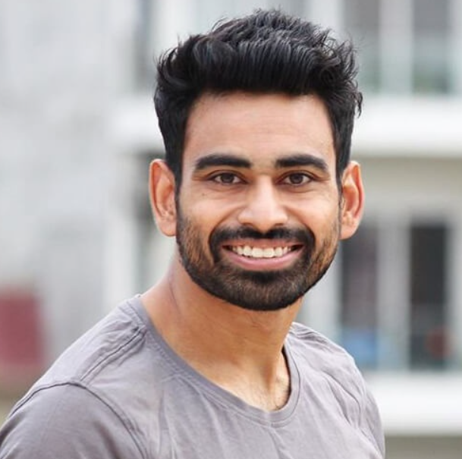
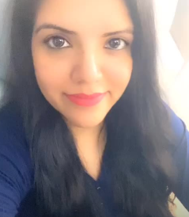
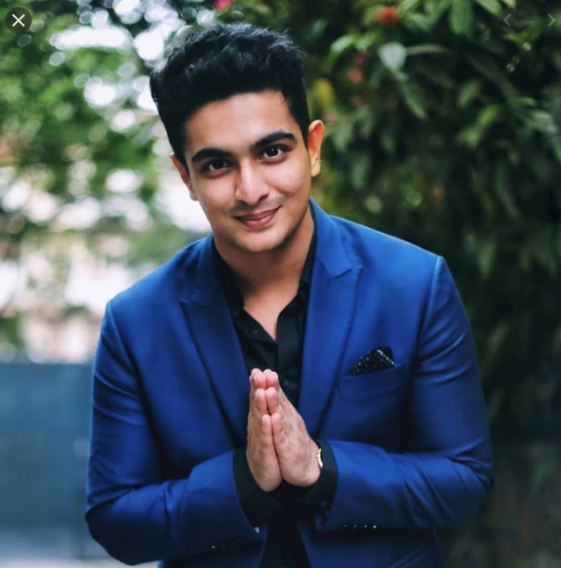
TOP FITNESS INFLUENCERS
Sahil Khan
5.3 M Followers
Fit Tuber
2.85 M Followers
Fitness 365 Days
1.8 M Followers
Beer Biceps
876 K Followers
Yasmin Karachiwala
818 K Followers

Slide 5
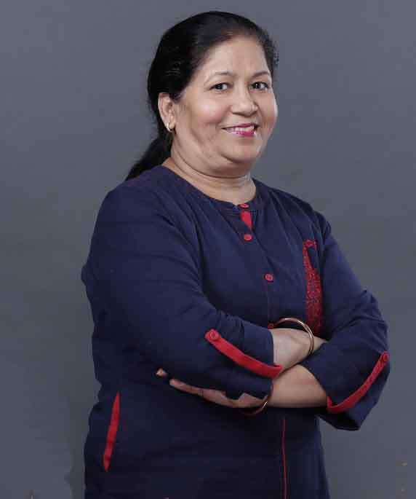
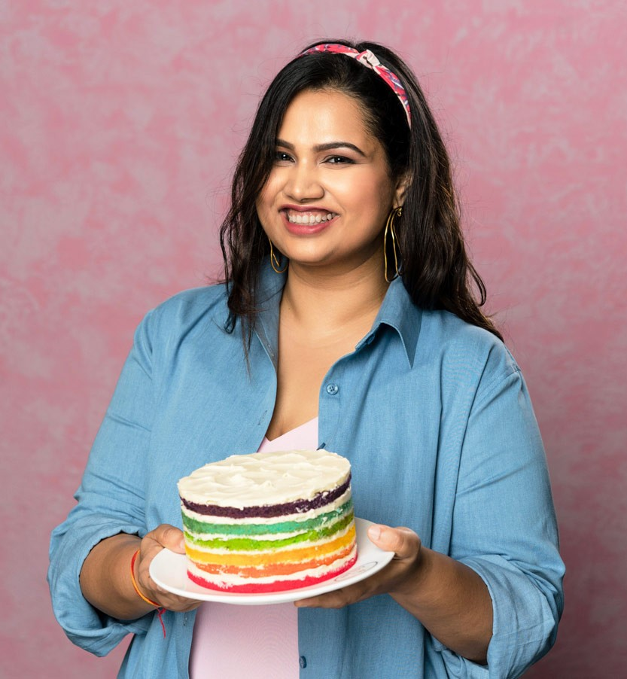
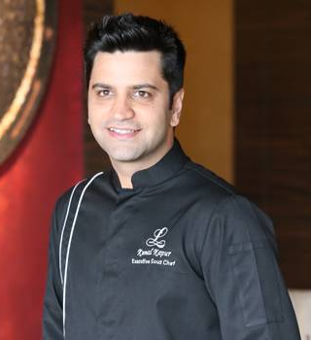
TOP CHEF INFLUENCERS
Nisha Madhulika
9.41 M Followers
Kabita’s Kitchen
7.66 M Followers
Pooja Dhingra
6.2 M Followers
Hebbar’s Kitchen
3.91 M Followers
Kunal Kapoor
1.9 M Followers

Slide 6
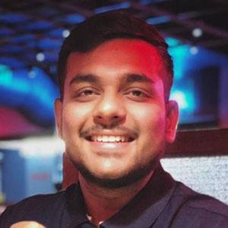
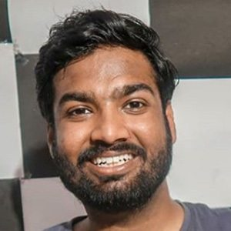
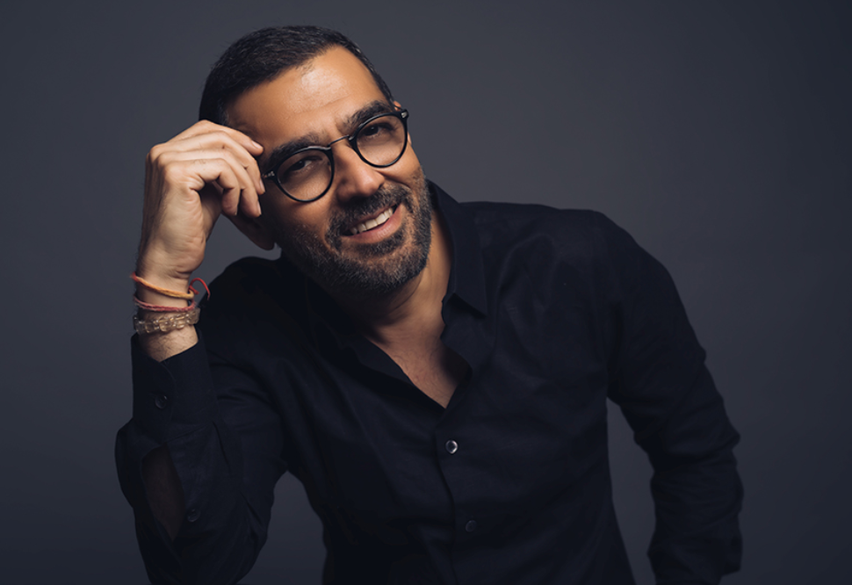
TOP FOOD INFLUENCERS
Viva Food World
3.41 M Followers
Dil Se Foodie
1.27 M Followers
Veggie Bhaaji
592 K Followers
Eat Treat
575 K Followers
Mumbai Foodie
445 K Followers

Slide 7
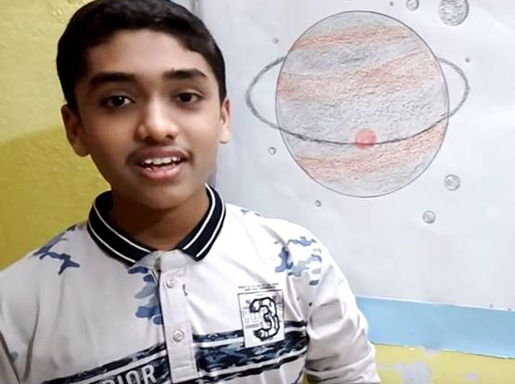
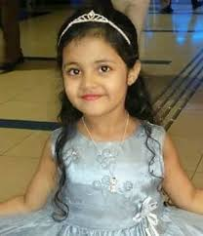
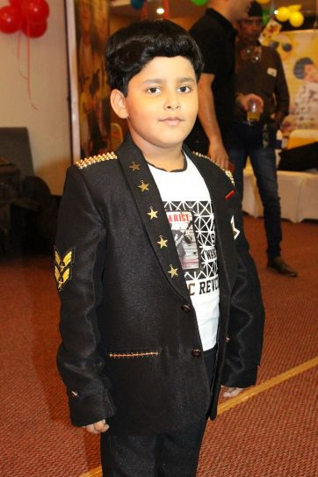
TOP KIDFLUENCERS
Miss Anand
7.34 M Followers
Aayu and Pihu Show
7.15 M Followers
Learn with Amar
322 K Followers
Wondergirl Ayat
182 K Followers
Jayas Kumar
145 K Followers

Slide 8
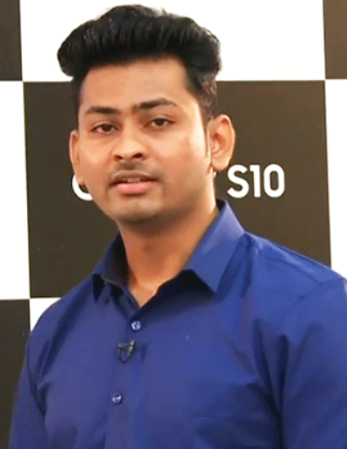
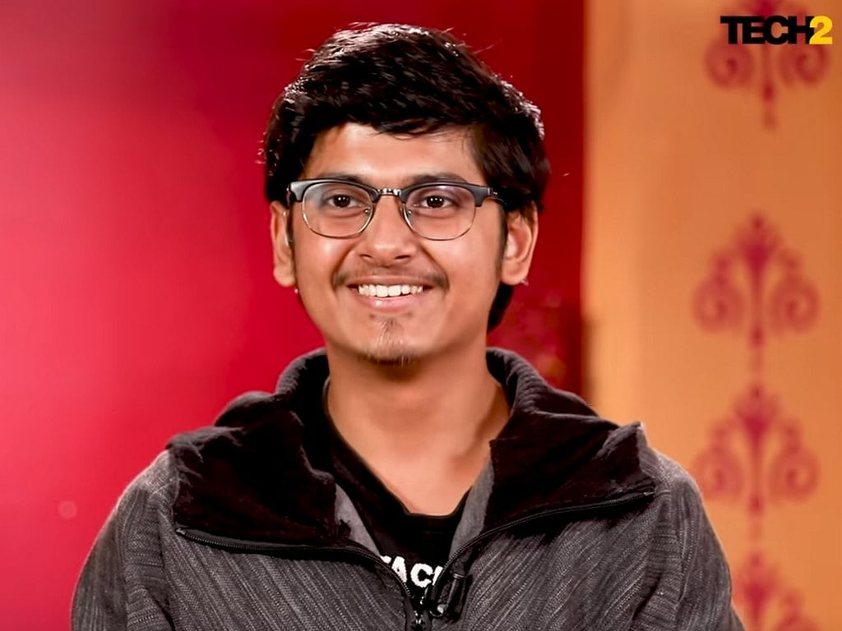
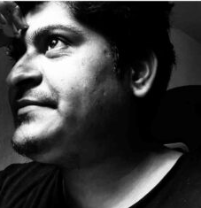
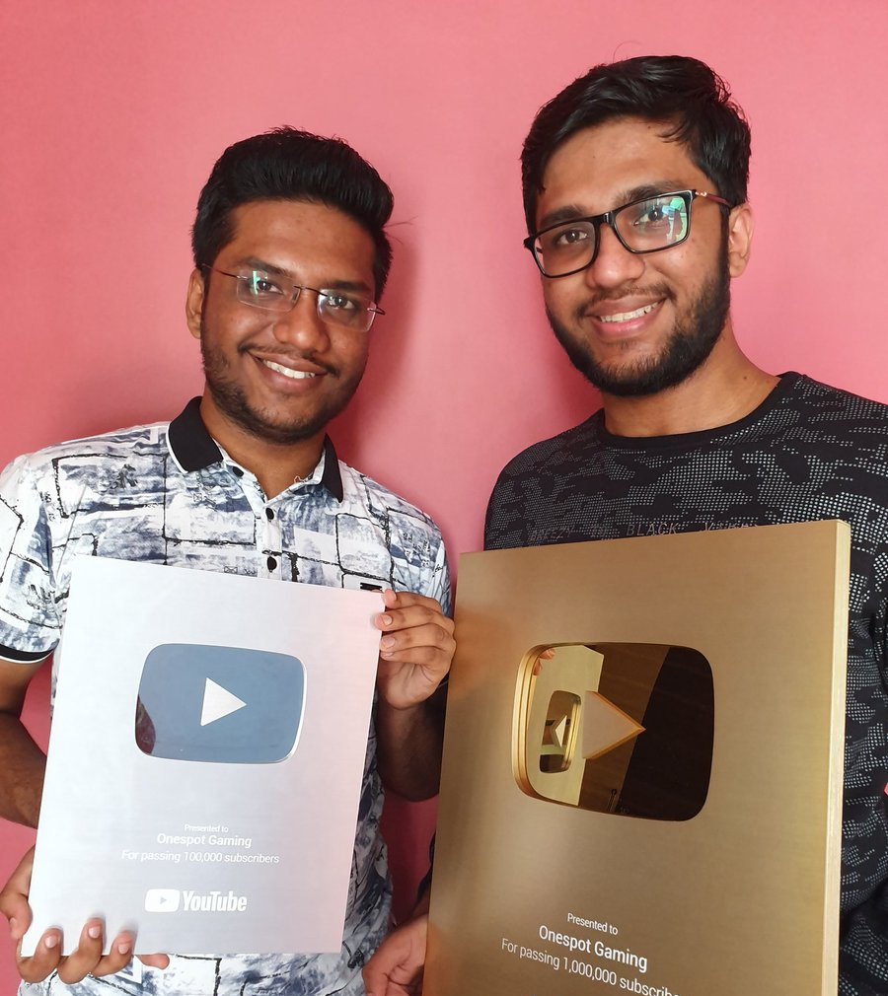
TOP GAMING INFLUENCERS
Dynamo
Gaming
7.59 M Followers
Mortal
5.01 M Followers
Gyan Gaming
2.64 M Followers
OneSpot
Gaming
2.17 M Followers
Kronten
Gaming
1.86 M Followers

Slide 9
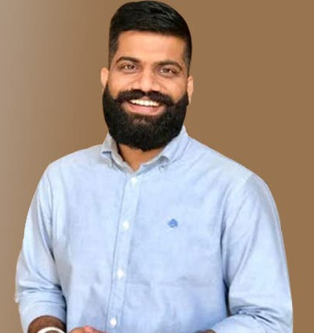
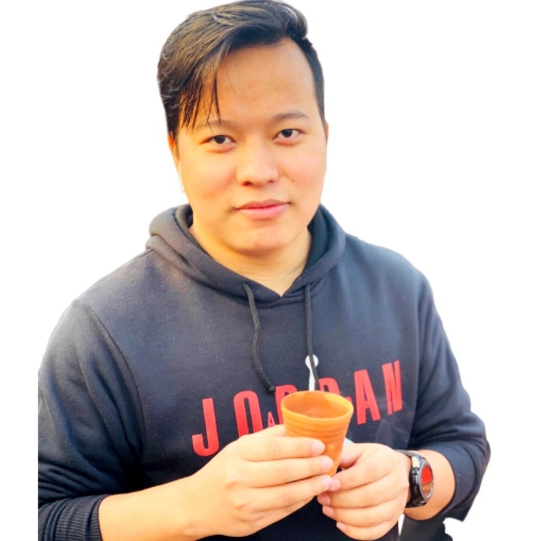
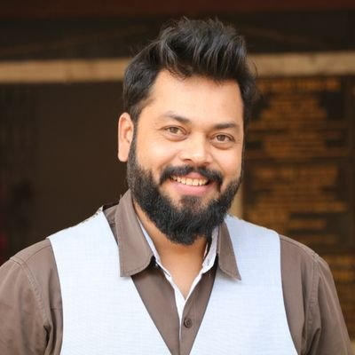
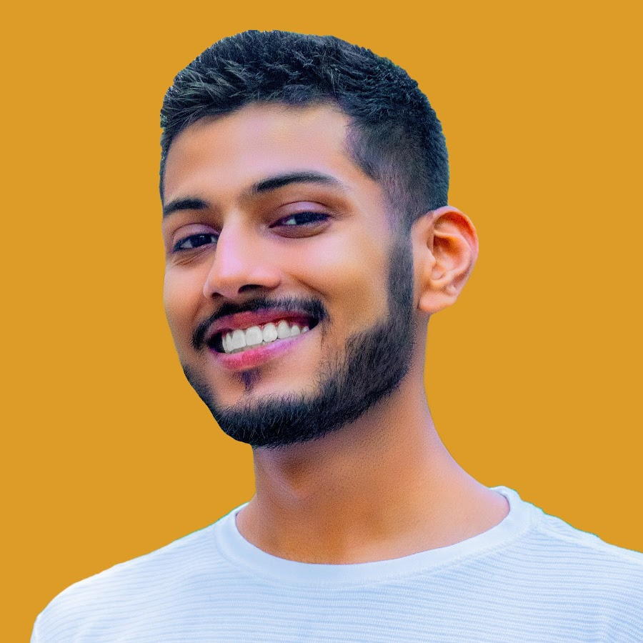
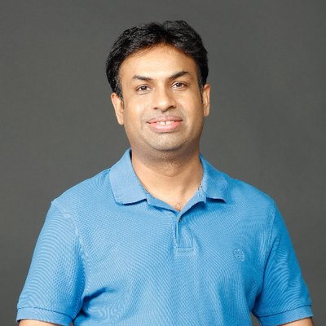
TOP TECH INFLUENCERS
Technical Guruji
17.2 M Followers
Technology Gyan
6.33 M Followers
Trackin
Tech
4.42 M Followers
Tech
Burner
3.16 M Followers
Geeky
Ranjeet
2.94 M Followers

Slide 10
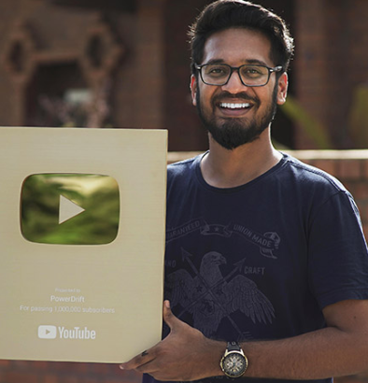
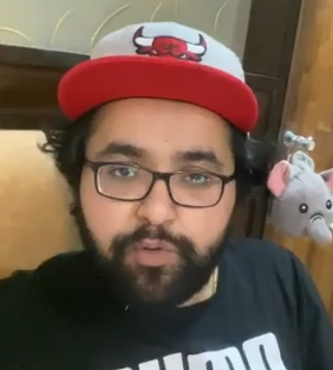
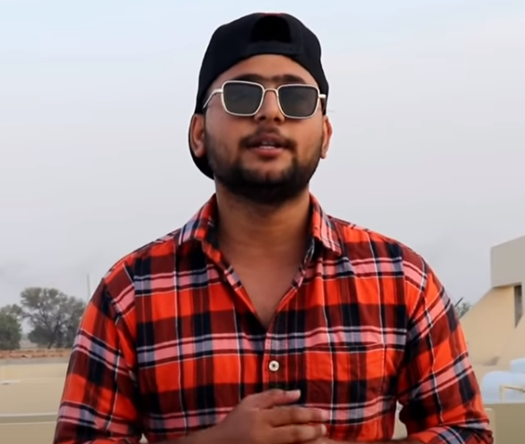
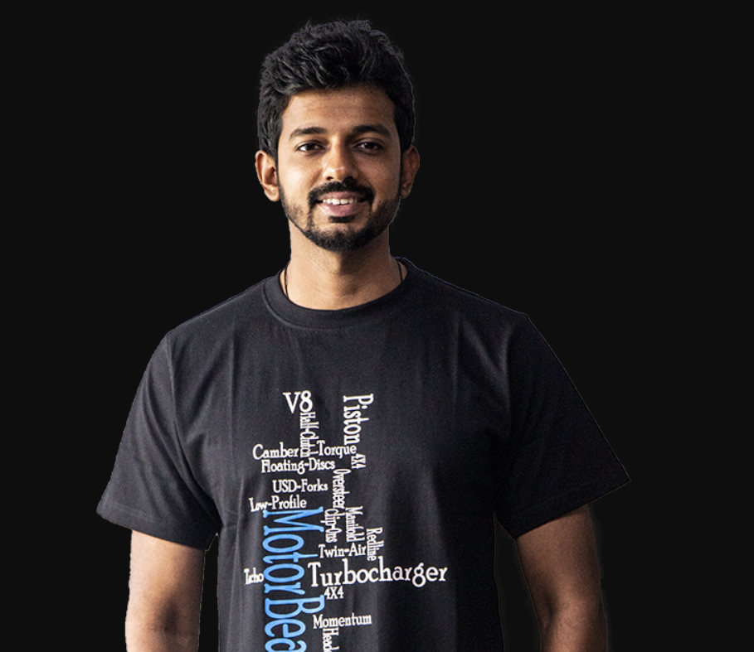
TOP AUTOMOBILE INFLUENCERS
PowerDrift
1.95 M Followers
Musafir
1.57 M Followers
Jatt Prabhjot
1.29 M Followers
Modified
Junction
635 K Followers
MotoBeam
337 K Followers

Slide 11
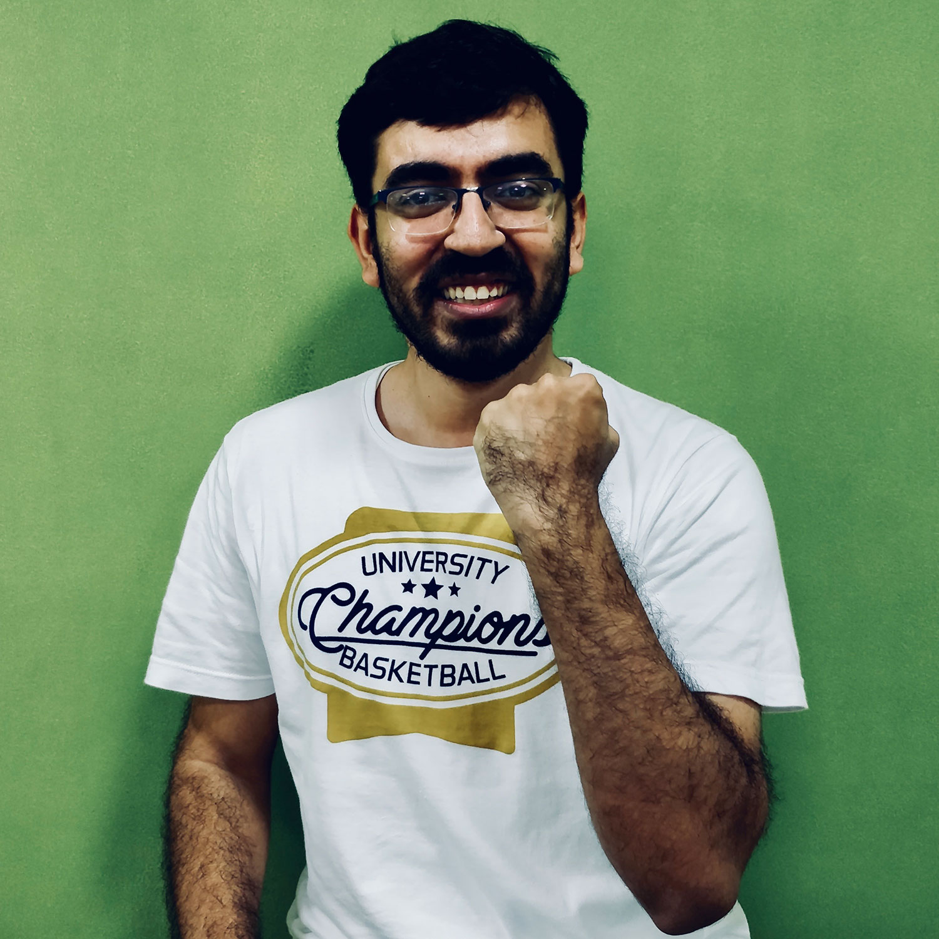
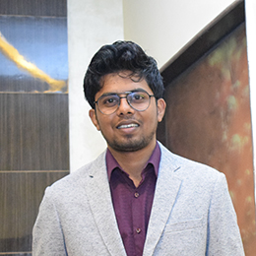
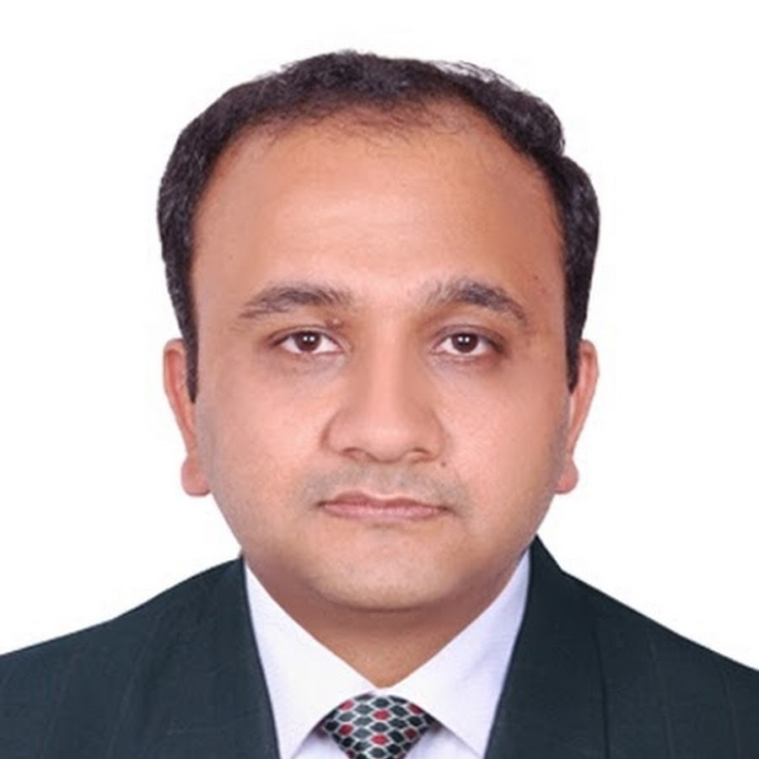
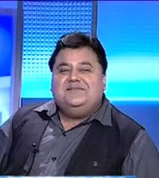
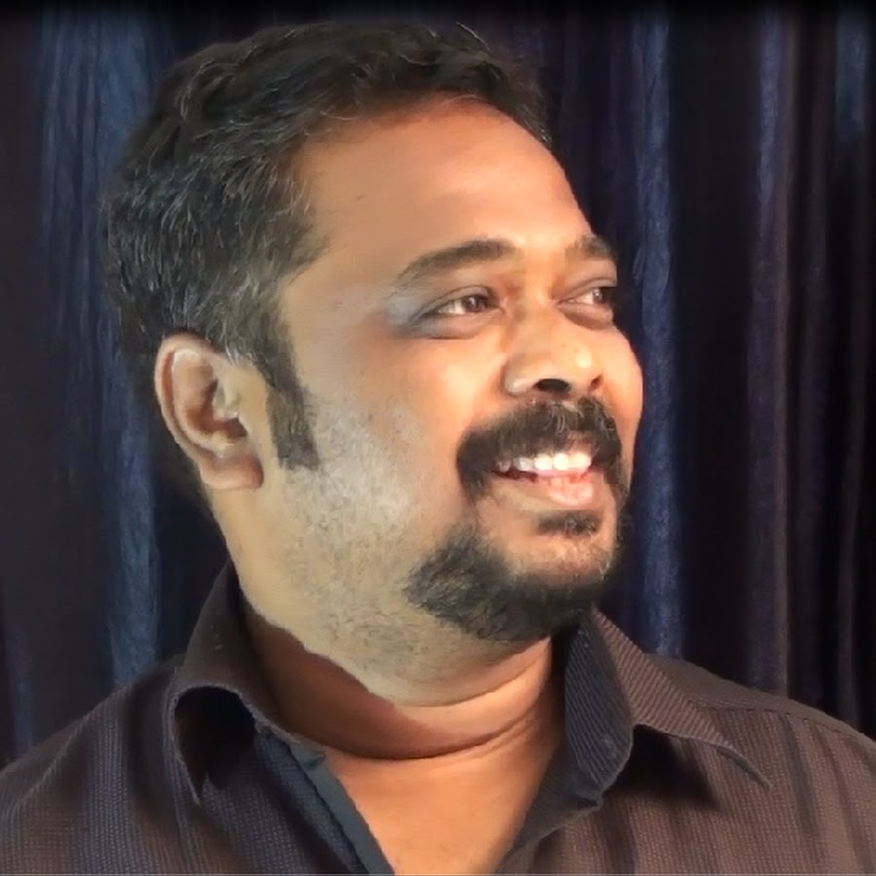
TOP FINANCE INFLUENCERS
Pranjal Kamra
1.5 M Followers
FinnovationZ
1.07 M
Followers
Nitin Bhatia
762 k Followers
Sunil Minglani
611 K Followers
Market Gurukul
413 K Followers

Slide 12
THANK YOU!
LIKE AND SHARE FOR MORE CONTENT
FOR MORE INSIGHTS,
Connect with us: contactus@thinkinghats.info

